Slide 1


Introduction
to
Game
Agung
Nugroho
Pramudhita M.T.
Development
Some Slides by:
Abdelrahman Shaheen

Slide 2


Agenda
• What are video games?
• What are video games genres?
• How big is the game industry to date?
• How to develop a video game from start to finish?
• What are the roles in the video games industry ?
• What is the career path for every team member?
• How to get into the video games industry?
• References

Slide 3
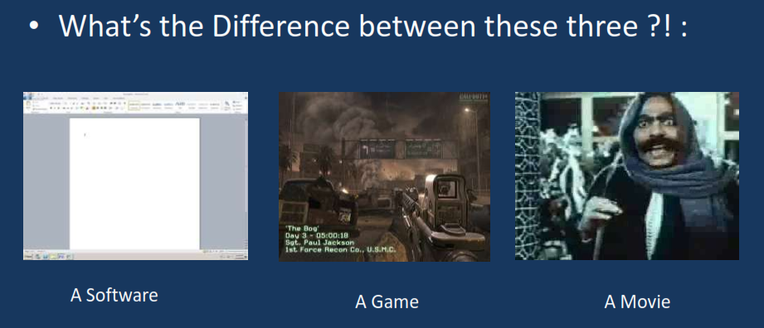
What are video games?

Slide 4
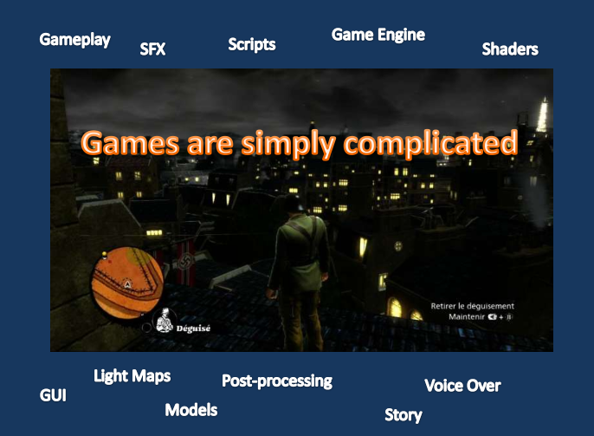
What are video games?

Slide 5
What are video games?
• A video game refers to any interactive content played by
electronically manipulating images produced
program or application on any display.
• Mobile & Tablet Games
• Web Games
• Console Games
• PC Games.
by
any
computer

Slide 6
What is the difference?
• Interactivity is what makes games differ from movie and other art
forms.
• The content of the game as a medium is what makes it differs
from other software. And obviously it is more fun.

Slide 7
Game Structure
Games have a different structure than any other software
– Start up
– Introductory Movie
– Front End
• Game Options
• Sound Options
• Video Options
– Loading Screen
– Main Game
• Introduction
• Gameplay
– game modes
• Pause Options
– End Game Movie
– Credits
– Shut down

Slide 8
What are video games genres?
• Games are often classified into genres, which purport to define
games in terms of having a common style or set of characteristics,
e.g. as defined in terms of perspective, gameplay, interaction,
objective, etc.

Slide 9
What
are
video
games
genres?
Adventure
Action
Action Adventure
Platform
Fighting
First Person Shooter
(FPS)
Real-time strategy
(RTS)
Turn-based strategy
games
Role playing games
(RPGs)
Rhythm games
(music games)
Puzzle games
Traditional games
Massively multiplayer online
Stealth games
Survival horror games
Simulation games
Racing games
Sports games
Educational games

Slide 10


How
big
is
the
game
industry
to
date?
• Avengers Infinity WAR
$640.5 million as its first week revenue
• Grand Theft Auto V
sold 11.21 million units in its first 24 hours, and generated revenue of $815.7 million
ek

Slide 11
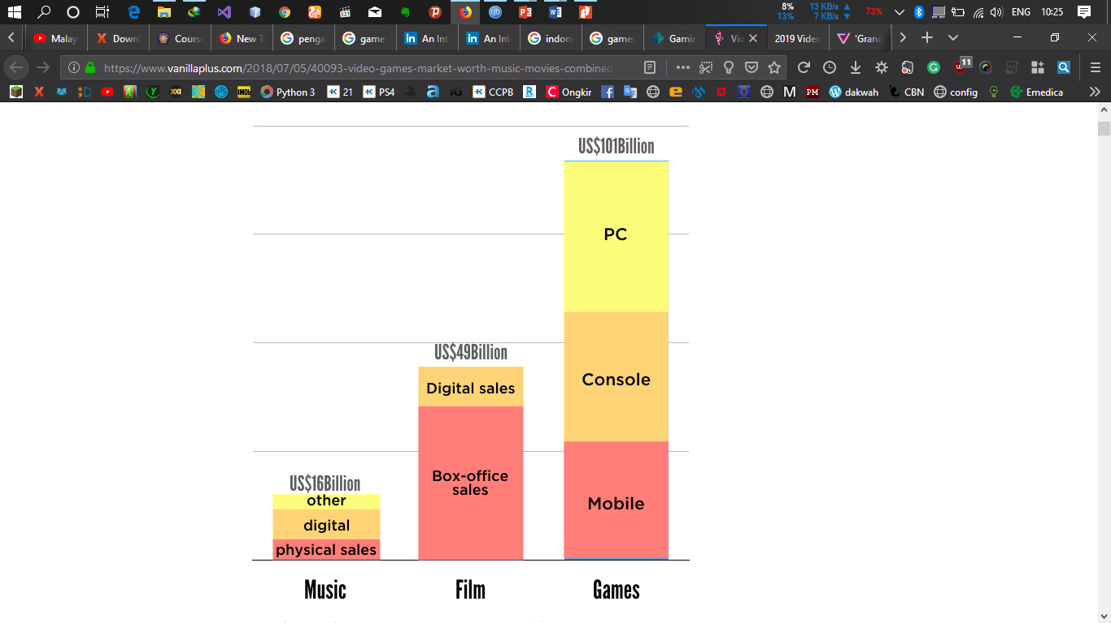
How
big
is
the
game
industry
to
date?
ek

Slide 12
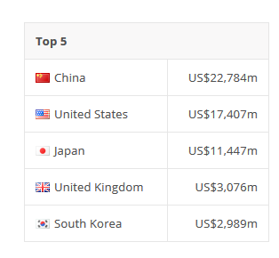
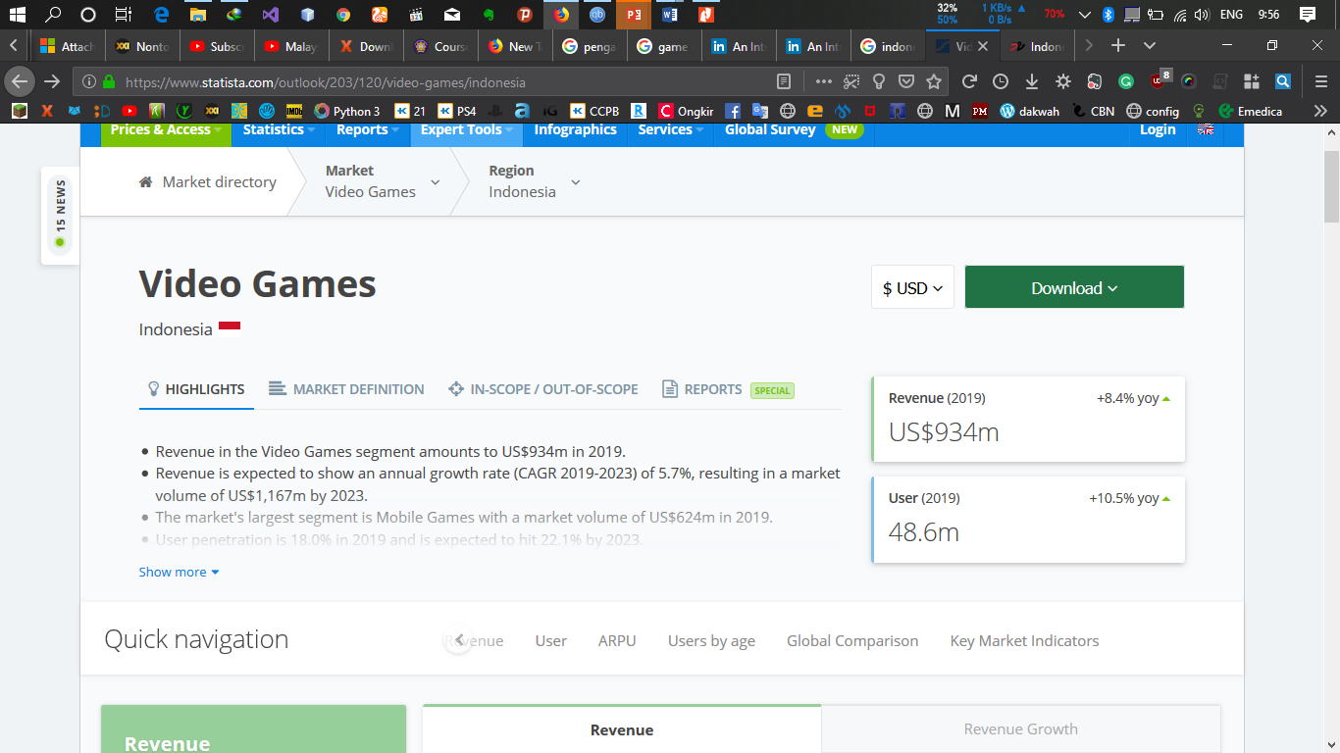
Top 100 Countries by
Game
Revenues
|
2019
Source: https://www.statista.com/outlook/203/120/video-games

Slide 13

companies
Source:
http://www.gamedevmap.com

Slide 14
How to develop a video
finish?
game
from
start to
• Game development process
Pre-production
Pitch
(Concept Document)
GCD
Project
Plan
Prototype(proof
of concept)
Production
Design
Programming
Art
Production
Audio
Production
QA(Testing)
Postproduction
Maintenance
Customer service
Patches and updates

Slide 15


Pre-production
• Pitch
• Game Design Document (GDD)

Slide 16
Production
• Game Design
• Game Art
• Programming
• Audio
• QA

Slide 17
Game Design
• Game Genre.
• Design Documents.
• The content and the rules of the game.
• Describe what the game what looks like and acts like.
• Game design is very critical and require experience and
knowledge.

Slide 18
Game Art
• Artists create all the images in a game including all the landscapes,
buildings and characters.
• 2D
▪ Concept Art
▪ Sprites
▪ Texture Art
▪ UI Art
• 3D
▪ Concept Art
▪ Modeling
▪ Texture
▪ Animation

Slide 19
Programming
• Game Engine
• Gameplay programming
• AI Programming
• Graphics Programming

Slide 20
Audio
• Recording, design and editing of sound effects.
• Sound design and audio engineering are growing in importance.
• These people will produce music, sound effects, dialogue and oversee voice performance.

Slide 21
QA
• QA means testing – from functionality and game play to
localization (testing in-game text and audio in foreign languages).
All bugs are reported, fixed and re-tested.
• QA is one of the best entry points into the industry for first-time job seekers . Graduates may accept a role as a tester to get their
‘toe in the door’ of a studio

Slide 22
Postproduction
• Maintenance
• Customer Service
• Patches and updates

Slide 23
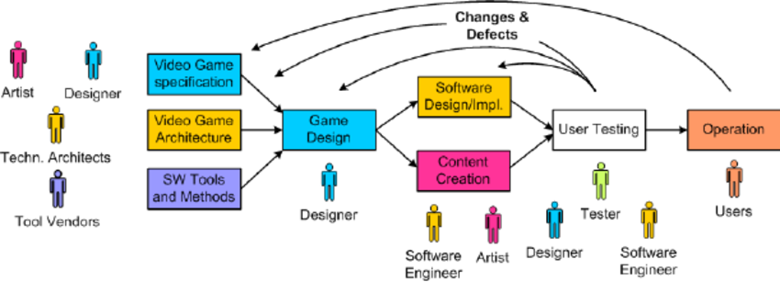
How to develop a video
finish?
game
from
start to
Pre-production
Pitch
(Concept Document)
GCD
Project
Plan
Prototype(proof
of concept)
Production
Design
Programming
Art
Production
Audio
Production
QA(Testing)
Postproduction
Maintenance
Customer service
Patches and updates

Slide 24
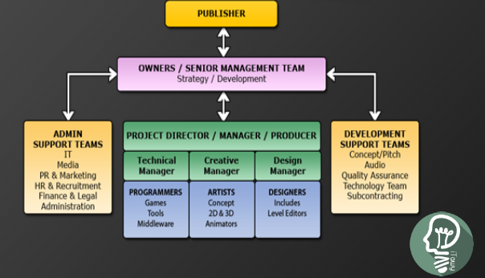





What are the
industry ?
roles
in
the
video
games
• Producer
• Publisher
• Development Team
PUBLUiH A
r;;;;;;;;;==· I
. · ]
OWN
RS Is NIOR MANA
St, ·teg� I Devel · ment
NI
Al
ADMIN
PPOR.T EAMS
IT
ed
PR &. ·,1a nketllllgr
Finance a Legal
Ip
R/
Rf PRO
DEV: OPMENT
SUPPOR EA
Gom:e�Pi rh
Audio
I
QuallliV
5Allr nee
HR
R
. I
I
NOGMMM!RS
ARTISTS
(onctpt
20&30
Ari I rnffllrs.
D!SIG
Ind
LM Edlt,c,�
1 )�lo«Y m
Su'.booniract g
Adt1H1
_ ·ion

Slide 25
Producer
•
•
May also referred to as project manager, project lead, or director.
Internal producer working for the developer, manages the development team, schedules, reports progress, hires and assigns staff, and so on.
External producer working for the publisher , oversees the developer progress and budget.
Producer’s responsibility includes PR, contract negotiation, liaising
between the staff and stockholders, schedule and budget
maintenance, quality assurance, beta test management, and
localization.
•
•

Slide 26
Publisher
• A video game publisher is a company publishes video games that
they have
either developed internally or have hade developed by
an external video developer.
• Responsible for manufacturing and marketing, include market research and all aspects of advertising.

Slide 27
Development
Team
• Designer
• Artist
• Programmer
• Sound engineer
• Tester

Slide 28
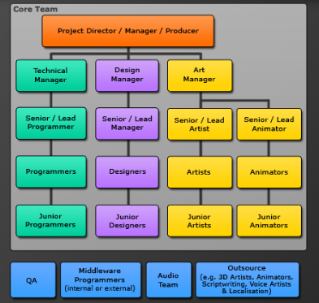
What is the
member?
career path for
every
team
core Team
Project Director I Manager I Producer
-·
Ill
•
Design
Manager
Ill
Technical
Manager
A.t-t
Manager
l
Senior I Lead
Programmer
I
Senior I Lead
Manager
I
I
I
Senicr I Lead
Artist
.Senioi- I Lead
Animatcr
l
Programmers
I
Designers
I
Artists
l
Animators
l
Junior
Programmers
I
Junior
Designers
I
Junior-
Artists
I
Junior
Animatcrs
�
Middleware
Programmers
(internal or extamal)
Audio
Team
Outsource
(e.g. JD Artists, Animators., Saiptwriting, Voice Artists
& Lacalisation)
QA
----
----
--

Slide 29
How to get into the video games industry?
• Answer to this question requires answering for two questions
• What to learn or skills needed to be video game developer?
• Where to get a job in the video game industry?

Slide 30
Passion
• First you should love video games, so this is more of a passion than
a skill, but if you want to get a job as a video game designer, you
have to love playing video games.
• Hiring managers want to know that you’re big into the world of gaming—knowing about the latest games, consoles, trends and what constitutes a good video game.

Slide 31
What are skills you need
developer?
to
be
video
game
• Game developer needed skills
•
•
•
•
•
•
•
•
•
•
Math
Physics
AI
Very good programing Skill Graphics (OpenGL, XNA) Algorithms
Data structure
Problem solver
Networking
Game engines (Unity, Cocos2d-x,YOYO, …)

Slide 32
What skills you need
to
be
game
designer?
• Creativity
• Practicality
• Problem solving – having an
• analytical attitude
• Excellent communication skills
• Team player

Slide 33
What skills you need to be
game
artist?
• 2D Artists
▪ 2D paint packages (Photoshop, Painter)
▪ 2D vector graphics packages (Illustrator)
• 3D Artists And Animators
▪ 3D packages (Maya, 3DS Max, Lightwave)
▪ Specialist 3D animation packages (e.g. Animator)
▪ 2D/traditional animation formats
▪ Game studios Animation.

Slide 34
What skills you need to be game animator?
• 3D packages (Maya, 3DS Max, Lightwave)
• Specialist 3D animation packages (e.g. Animator)
• 2D/traditional animation formats
• Game studios Animation.

Slide 35
What skills you need to be game tester?
• Bug tracking software skills
• Excellent written and verbal communication skills
• Team player
• Attention to detail

Slide 36
What skills you
engineer?
need
to
be
game
audio
• Good communication
• Attention to detail
• Knowledge of audio editing software (e.g. Soundforge)

Slide 37
Where to get
industry?
a
job
in
the
video
game
• Gaming company
• Indie game

Slide 38
Indie game
• Video games created by individuals or small teams generally
without video game publisher financial support. Indie games often
focus on innovation and rely on digital distribution.
• Indie gaming has seen a rise in the latter half of the 2000s decade, primarily due to new online distribution methods and development tools.

Slide 39


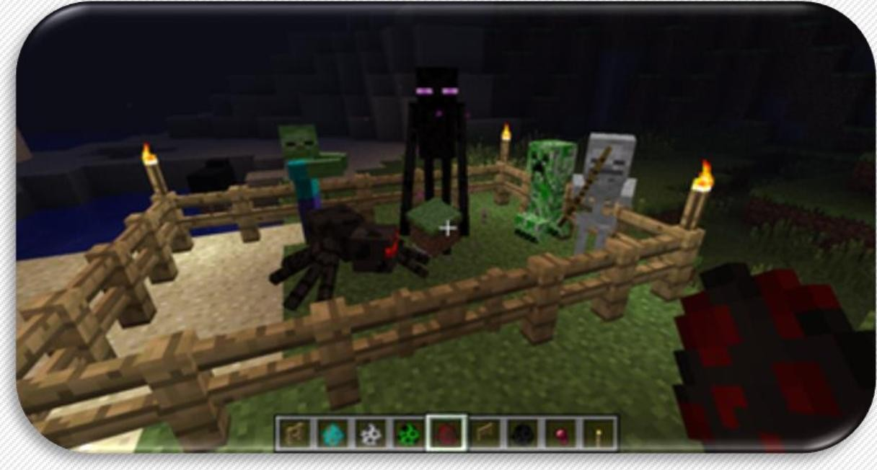
Indie game
• Some games
originated as indie
have become very
successful financially
• Braid, World of Goo, and Minecraft.

Slide 40
Publishing you game
• Publishing video game become so simple today
• Playstore, Appstore, Xbox store,..
• Game website
• Facebook
• Online games

Slide 41
Monetizing
• Advertising
• Banner ads
• Interstitials between levels
• More games button
• Game Exit
• Selling data

Slide 42
Monetizing
• Selling Content (DLC)
• Premium version –You release a light version of your game and allow users
to upgrade to the full version via an In-App Purchase.
• Worlds (visual customizations) – with this option you create and sell a customized version of the original game by modifying the look and feel of the game.
• Wallpapers – some users will like your game so much, they will buy a
wallpaper for their phone.
• Ringtones – if you composed an original music for your game you could sell it in your store.

Slide 43
Monetizing
• Limitation Removal
• Remove ads
• More Energy/Life/Turns
• More Time

Slide 44
Monetizing
• Virtual Economy
• Double coins
• Save Me
• Discoverable items

Slide 45
Monetizing
• Merchandising
• T-shirts – Your fans want to show how much they love your game? You can
sell t-shirts in your game.
• Lunch boxes – Popular Merchandising option with kids games.
• Branded cases – What could be a better match for a game then a shield for the user smartphone.

Slide 46
References
• http://blog.gameanalytics.com/
• http://www.blitzgamesstudios.com/
• http://unity3d.com/learn/
• http://www.cocos2d-x.org/
• http://www.sonarlearning.co.uk/
• http://ocw.mit.edu/courses/comparative-media-studies- writing/cms-611j-creating-video-games-fall-2013/audio-lectures/

